Slide 1
Benchmarking for Large-Scale Placement and Beyond
S. N. Adya, M. C. Yildiz, I. L. Markov,
P. G. Villarrubia, P. N. Parakh, P. H. Madden

Slide 2
Outline
Motivation
  Why does the industry need benchmarking?
Available benchmarks and placement tools
  Performance results
Unresolved issues
  Benchmarking for routability
  Benchmarking for timing-driven placement
Public placement utilities
Lessons learned + beyond placement

Slide 3
A True Story About Benchmarking
An undergraduate student implements
an optimal B&B block packer,
finds min areas possible for apte & xerox,
compares to published results,
finds an ISPD 2001 paper that reports:
  Floorplan areas smaller than optimal
  In two cases, areas smaller than Σ block areas
More true stories in our ISPD 2003 paper

Slide 4
Industrial Benchmarking
Growing size & complexity of VLSI chips
  Design objectives
    Wirelength / congestion / timing / power / yield
  Design constraints
    Fixed die / routability / FP constraints /
    fixed IPs / cell orientations / pin access /
    signal integrity / …
Can the same algo excel in all contexts?
Layout sophistication motivates
open benchmarking for placement

Slide 5
Whitespace Handling
Modern ASICs are laid out in fixed-die context
  Layout area, routing tracks, power lines, etc
  are fixed before placement
  Area minimization is irrelevant (area is fixed)
  New phenomenon: whitespace
  Row utilization % = density % = 100% - whitespace %
How does one distribute whitespace ?
  Pack all cells to the left [Feng Shui, mPL]
    All whitespace is on the right
    Typical for variable-die placers
  Distribute uniformly [Capo, Kraftwerk]
  Allocate whitespace to congested regions [Dragon]

Slide 6
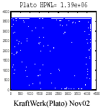
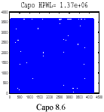
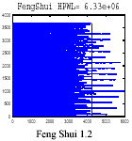
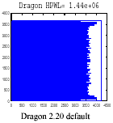
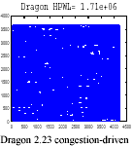
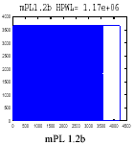

Slide 7
Design Types
ASICs
  Lots of fixed I/Os, few macros, millions of standard cells
  Placement densities : 40-80% (IBM)
  Flat and hierarchical designs
SoCs
  Many more macro blocks, cores
  Datapaths + control logic
  Can have very low placement densities : < 20%
Micro-Processor (μP) Random Logic Macros(RLM)
  Hierarchical partitions are placement instances (5-30K)
  High placement densities : 80%-98% (low whitespace)
  Many fixed I/Os, relatively few standard cells
  Recall “Partitioning w Terminals” DAC`99, ISPD `99, ASPDAC`00

Slide 8
ASICs
Many fixed ports: perimeter- and area-array
A handfull (1-20) of large, fixed macros
100's to 1000's of fixed smaller cells
Some designs are hierarchical
  E.g., have floorplan constraints
  Functional / logic hierarchy ≠ physical hierarchy
Many designs are flat
Up to 2M placeable objects (for flat designs)

Slide 9
Cores
Computational and DSP cores
are commonly included in SoCs
Mix of standard-cell and semi-custom style
Datapaths, structured components
Some control logic

Slide 10
μP RLMs
Manual floorplanning, hierarchies
Standard-cell Place & Route instances are small (5K to 30K placeable objects)
Std. cells sometimes occupy a single row
Almost no whitespace
Large ratio of fixed ports to movable cells
(relative to ASIC parts)
  Most cells are movable, but not always
  Recall “Partitioning w Terminals” DAC`99, ASPDAC`00

Slide 11
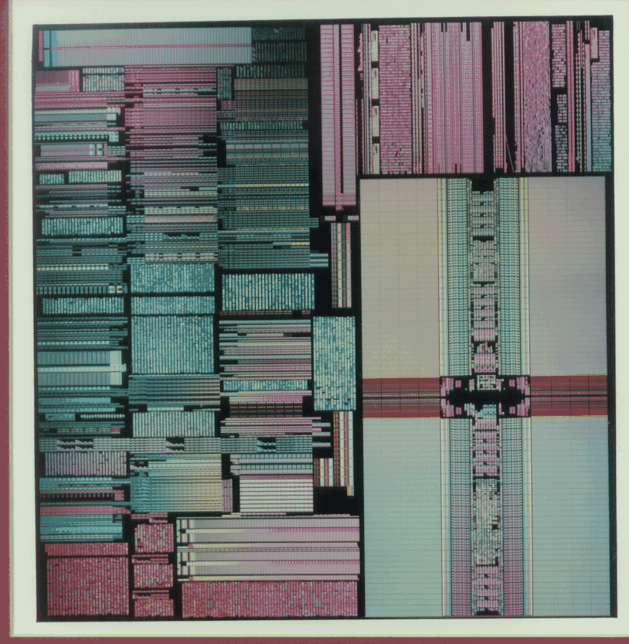
IBM PowerPC 601 chip

Slide 12
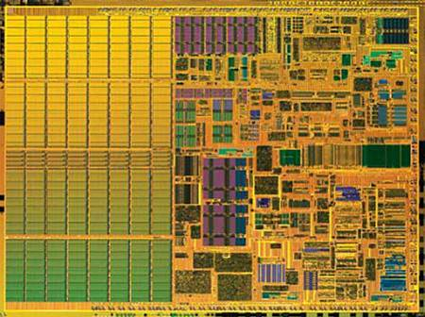
Intel Centrino chip

Slide 13
Requirements for Placers (1)
Must handle 4-10M cells, 1000s macros
  64 bits + near-linear asymptotic complexity
  Scalable/compact design database (OpenAccess)
Accept fixed ports/pads/pins + fixed cells
Place macros, esp. with var. aspect ratios
  Non-trivial heights and widths
  (e.g., height=2rows)
Honor targets and limits for net length
Respect floorplan constraints
Handle a wide range of placement densities
(from <25% to 100% occupied), ICCAD `02

Slide 14
Requirements for Placers (2)
Add / delete filler cells and Nwell contacts
Ignore clock connections
ECO placement
  Fix overlaps after logic restructuring
  Place a small number of unplaced blocks
Datapath planning services
  E.g., for cores
Provide placement dialog services
to enable cooperation across tools
  E.g., between placement and synthesis

Slide 15
Why Worry About Benchmarking?
Variety of conflicting objectives
Multitude of layout features / constraints
  No single algorithm finds best placements
  for all design problems (yet?)
Need independent evaluation
  Need a set of common placement BM’s with features of interest (e.g., IBM-Floorplacement)
Need to know / understand how algorithms behave over the entire design space

Slide 16
Available Placement BM’s
MCNC
  Small and outdated (routing channels between rows, etc)
IBM-Place / IBM-Dragon (ste 1 & 2) - UCLA (ICCAD `00)
  Derived from ISPD98-IBM partitioning suite. Macros removed.
IBM Floor-placement – Michigan (ISPD ‘02)
  Derived from same IBM circuits. Nothing removed.
PEKO – UCLA (DAC ‘95, ASPDAC ‘03, ISPD ‘03)
  Artificial netlists with known optimal wirelength; up to 2M cells
  No global wires
Standardized grids – Michigan
  Created to model data-paths during placement
  Easy to visualize, optimal placements are obvious
Vertical benchmarks - CMU
  Multiple representations (PicoJava, Piperench, CMUDSP)
  Have some timing info, but not enough to evaluate timing

Slide 17
Academic Placers We Used
Kraftwerk Nov 2002 (no major changes since DAC98)
  Eisenmann and Johannes (TU Munch)
  Force-directed (analytical) placer
Capo 8.5 / 8.6 (Apr / Nov 2002)
  Adya, Caldwell, Kahng and Markov (UCLA and Michigan)
  Recursive min-cut bisection (built-in partitioner MLPart)
Dragon 2.20 / 2.23 (Sept / Feb 2003)
  Choi, Sarrafzadeh, Yang and Wang (Northwestern and UCLA)
  Min-cut multi-way partitioning (hMetis) & simulated annealing
FengShui 1.2 / 1.6 / 2.0 (Fall 2000 / Feb 2003)
  Madden and Yildiz (SUNY Binghamton)
  Recursive min-cut multi-way partitioning (hMetis + built-in)
mPL 1.2 / 1.2b (Nov 2002 / Feb 2003)
  Chan, Cong, Shinnerl and Sze (UCLA)
  Multi-level enumeration-based placer

Slide 18
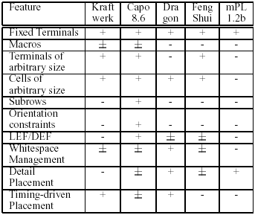
Features Supported by Placers

Slide 19
Performance on Available BM’s
Our objectives and goals
  Perform first-ever comprehensive evaluation
  Seek trends and anomalies
  Evaluate robustness of different placers
One does not expect a clear winner
Minor obstacles and potential pitfalls
  Not all placers are open-source / public
  Not all placers support the Bookshelf format
    Most do
    Must be careful with converters (!)

Slide 20
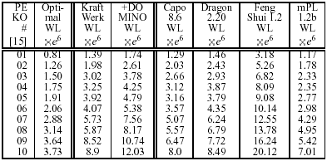
PEKO BMs (ASPDAC 03)

Slide 21
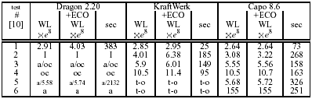
Cadence-Capo BMs (DAC 2000)
I – failure to read input; a – abort
oc – out-of-core cells; / - in variable-die mode
Feng Shui – similar to Dragon, better on test1

Slide 22
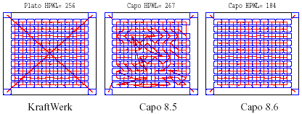
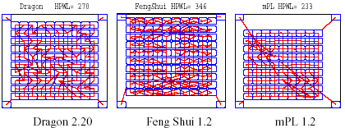
Results : Grids
Unique optimal solution

Slide 23
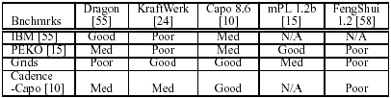
Relative Performance
?
Feng Shui 1.6 / 2.0 improves upon FS 1.2

Slide 24
Placers Do Well on Benchmarks Published By the Same Group
Observe that
  Capo does well on Cadence-Capo
  Dragon does well on IBM-Place (IBM-Dragon)
  Not in the table: FengShui does well on MCNC
  mPL does well on PEKO
This is hardly a coincidence
Motivation for more / better benchmarks

Slide 25
Benchmarking for Routability of Placements
Placer tuning also explains routability results
  Dragon performs well on the IBM-Dragon suite
  Capo performs well on the Cadence-Capo suite
  Routability on one set does not guarantee much
Need accurate / common routability metrics
  … and shared implementations (binaries, source code)
Related benchmarking issues
  No good public benchmarks for routing !
  Routability may conflict with timing / power optimizations

Slide 26
Simple Congestion Metrics
Horizontal vs. Vertical wirelength
  HPWL = WL_{H}+WL_{V}
  Two placements with same HPWL
  may have very different WL_{H} and WL_{V}
    Think of preferred-direction routing & odd #layers
Probabilistic congestion maps
  Bhatia et al – DAC 02
  Lou et al - ISPD 00, TCAD 01
  Carothers & Kusnadi – ISPD 99`

Slide 27
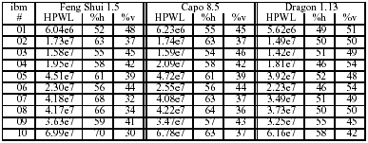
Horizontal vs. Vertical WL

Slide 28
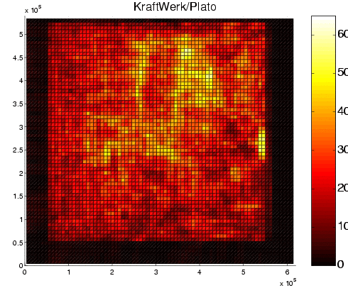
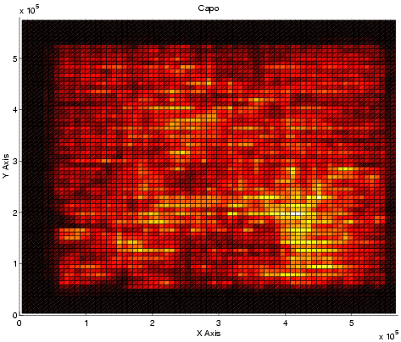
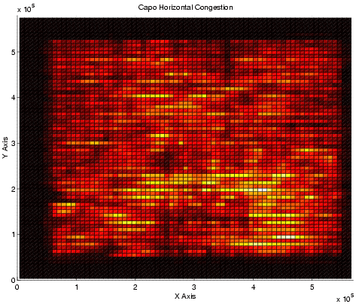
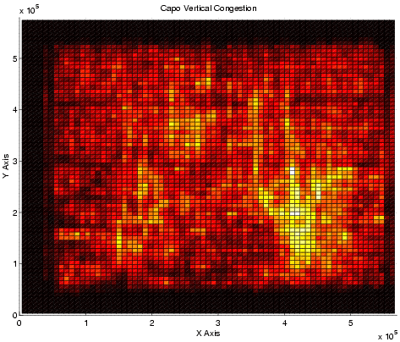
Probabilistic Congestion Maps

Slide 29
Metric: Run a Router
Global or Global + detail?
  Local effects (design rules, cell libraries)
  may affect results too much
    “noise” in global placement (for 2M cells) ?
Open-source or Industrial?
  Tunable? Easy to integrate?
  Saves global routing information?
Publicly available routers
  Labyrinth from UCLA
  Force-directed router from UCB

Slide 30
Placement Utilities
http://vlsicad.eecs.umich.edu/BK/PlaceUtils/
Accept input in the GSRC Bookshelf format
Format converters
  LEF/DEF ↔ Bookshelf
  Bookshelf → Kraftwerk
  BLIF(SIS) → Bookshelf
Evaluators, checkers,
postprocessors and plotters
  Contributions in these categories are esp. welcome

Slide 31
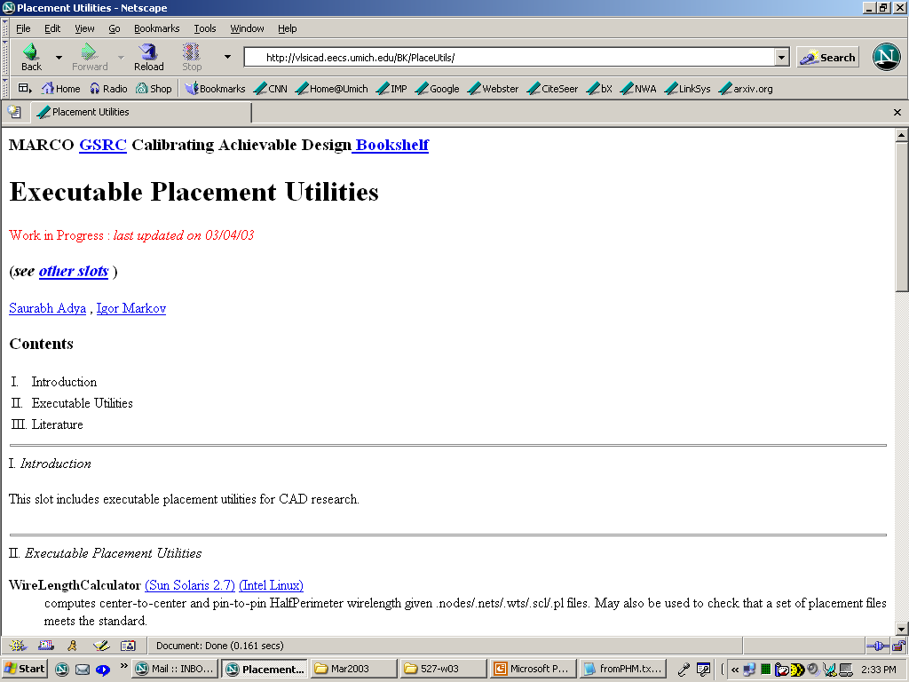

Slide 32
Placement Utilities (cont’d)
Wirelength Calculator (HPWL)
  Independent evaluation of placement results
Placement Plotter
  Saves gnuplot scripts (→ .eps, .gif, …)
  Multiple views (cells only, cells+nets, rows,…)
  Used earlier in this presentation
Probabilistic Congestion Maps (Lou et al.)
  Gnuplot scripts
  Matlab scripts
    better graphics, including 3-d fly-by views
  .xpm files (→ .gif, .jpg, .eps, …)

Slide 33
Placement Utilities (cont’d)
Legality checker
Simple legalizer
Layout Generator
  Given a netlist, creates a row structure
  Tunable %whitespace, aspect ratio, etc
All available in binaries/PERL at
  http://vlsicad.eecs.umich.edu/BK/PlaceUtils/
Most source codes are shipped w Capo
Your contributions are welcome

Slide 34
Challenges for Evaluating
Timing-Driven Optimizations
QOR not defined clearly
  Max path-length? Worst set-up slack?
  With false paths or without?...
Evaluation methods are not replicable (often shady)
  Questionable delay models, technology params
  Net topology generators (MST, single-trunk Steiner trees)
  Inconsistent results: path delays < Σ gate delays
Public benchmarks?...
  Anecdote: TD-place benchmarks in Verilog (ISPD `01)
  Companies guard netlists, technology parameters
  Cell libraries; area constraints

Slide 35
Metrics for Timing + Reporting
STA non-trivial: use PrimeTime or PKS
Distinguish between optimization and evaluation
  Evaluate setup-slack using commercial tools
  Optimize individual nets and/or paths
    E.g., net-length versus allocated budgets
Report all relevant data
  How was the total wirelength affected?
  Were per-net and per-path optimizations successful?
  Did that improve worst slack or did something else?
    Huge slack improvements reported in some 1990s papers,
    but wire delays were much smaller than gate delays

Slide 36
Impact of Physical Synthesis
Local circuit tweaks improve worst slack
How do global placement changes affect slack, when followed by sizing, buffering…?
Slack (TNS)
# Inst
Initial
Sized
Buffered
D1
22253
-2.75 (-508)
-2.17 (-512)
-0.72 (-21)
D2
89689
-5.87 (-10223)
-5.08 (-9955)
-3.14 (-5497)
D3
99652
-6.35 (-8086)
-5.26 (-5287)
-4.68 (-2370)
D4
147955
-7.06 (-7126)
-5.16 (-1568)
-4.14 (-1266)
D5
687946
-8.95 (-4049)
- 8.80 (-3910)
-6.40 (-3684)

Slide 37
Correlated Non-timing Metrics?
If you cannot solve a hard problem,
reduce it to a simpler problem
  Validate your reduction !
  E.g., show that slack correlates with ??...
Delay budgeting and net-length limits
  Before placement, for the whole chip
  Or in the context of incremental re-placement
Do some placement algorithms lead to smaller circuit delays ? (w/o timing info!)
  Recall: quadratic net lengths versus linear

Slide 38
Benchmarking Needs for Timing Opt.
A common, reusable STA methodology
  PrimeTime or PKS
  High-quality, open-source infrastructure (funding?)
Metrics validated against phys. synthesis
  The simpler the better, but must be good predictors
Benchmarks with sufficient info
  Flat gate-level netlists
  Library information ( < 250nm )
  Realistic timing & area constraints

Slide 39
Beyond Placement (Lessons)
Evaluation methods for BMs must be explicit
  Prevent user errors (no TD-place BMs in Verilog)
  Try to use open-source evaluators to verify results
Visualization is important (sanity checks)
Regression-testing after bugfixes is important
Need more open-source tools
  Complete descriptions of algos lower barriers to entry
Need benchmarks with more information
  Use artificial benchmarks with care
Huge gaps in benchmarking for routers

Slide 40
Beyond Placement (cont’d)
Need common evaluators of delay / power
  To avoid inconsistent results
Relevant initiatives from Si2
  OLA (Open Library Architecture)
  OpenAccess
  For more info, see http://www.si2.org
Still: no reliable public STA tool
Sought: OA-based utilities for timing/layout

Slide 41



Acknowledgements
Funding: GSRC (MARCO, SIA, DARPA)
Funding: IBM (2x)
Equipment grants: Intel (2x) and IBM
Thanks for help and comments
  Frank Johannes (TU Munich)
  Jason Cong, Joe Shinnerl, Min Xie (UCLA)
  Andrew Kahng (UCSD)
  Xiaojian Yang (Synplicity)

